Slide 1


Slide 2
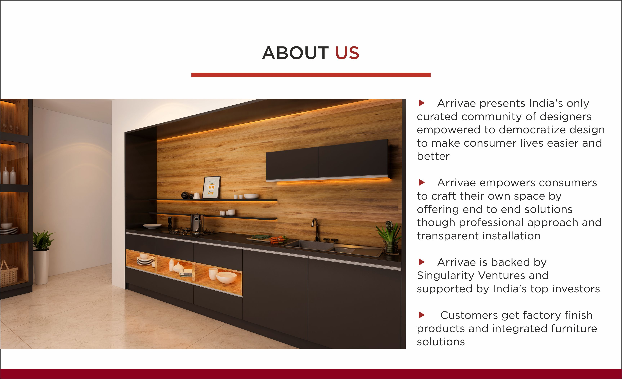

Slide 3
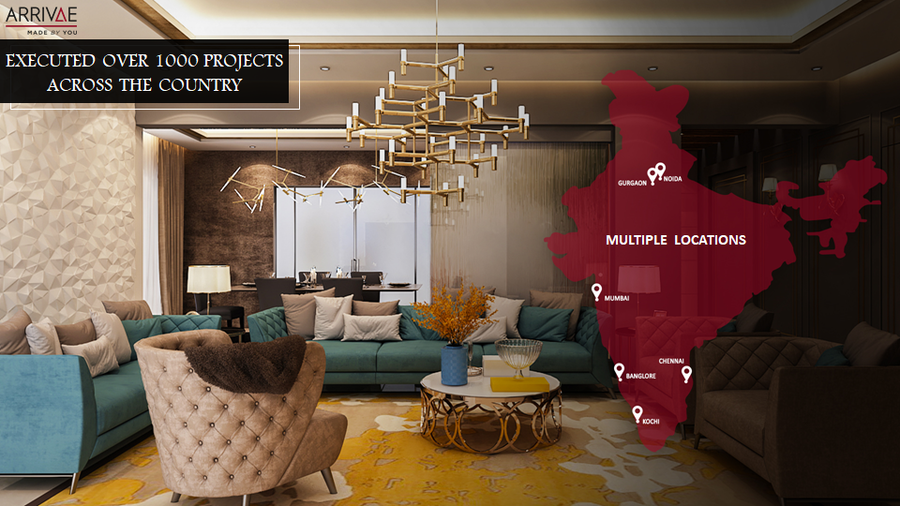

MULTIPLE LOCATIONS

Slide 4
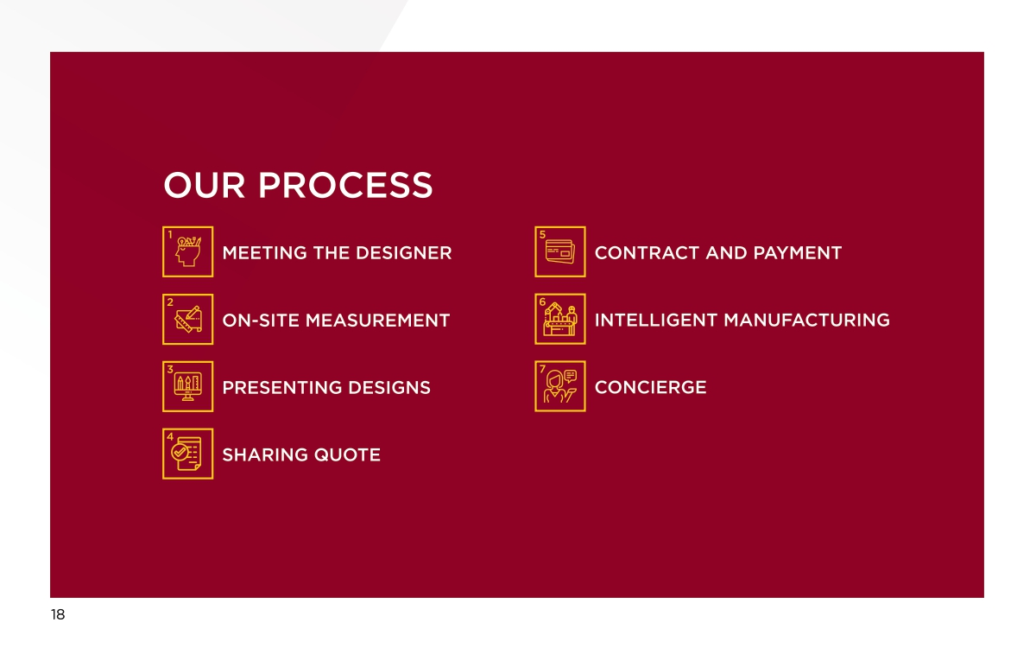

Slide 5
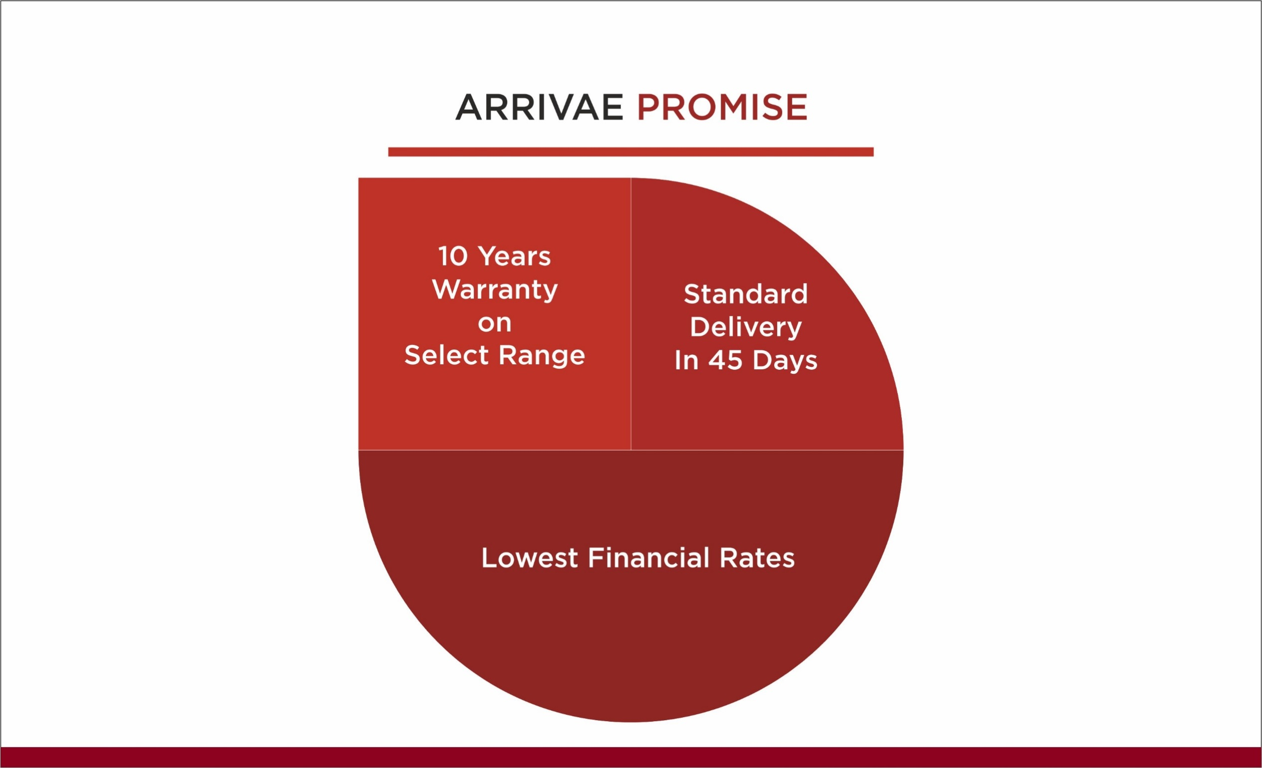
60 Days Delivery Period
Tenure : Upto 25 Years

Slide 6


Proposition –MR. NAME
Our Product & Service Solutions

Slide 7
Customer Profile
Residence –Kanakia Forest , Andheri East.
Profession – Doctor (40 Year)
Family – Wife (37 Year), Son (13 years) & Daughter(8 years).
Theme – Minimalist with pastel shades.

Slide 8
Customer Behavior
Husband – Work, Reading, Watch News.
Wife – Work, Reading, Watching TV.
Daughter – Work, Reading, Socializing with friends.
Son – Study, Playing Guitar, Sports

Slide 9
Customer Requirements
Living & Dinning – Extra Seating space, Book rack, TV Unit & Dining space with Crockery Unit.
Master Bedroom – Sleeping, Reading space, Book storage space, Dresser.
Daughter’s Bedroom – Sleeping, Reading space, Seating area, Dresser.
Son’s Bedroom / Study Room – Sleeping, Reading space, Place for guitar.

Slide 10
AREA REQUIRMETS
LIVING ROOM
MASTER BEDROOM
DAUGHTER’S BEDROOM
SON’S BEDROOM / STUDY ROOM

Slide 11

FLOOR PLAN

Slide 12
LIVING ROOM PROPOSAL

Slide 13
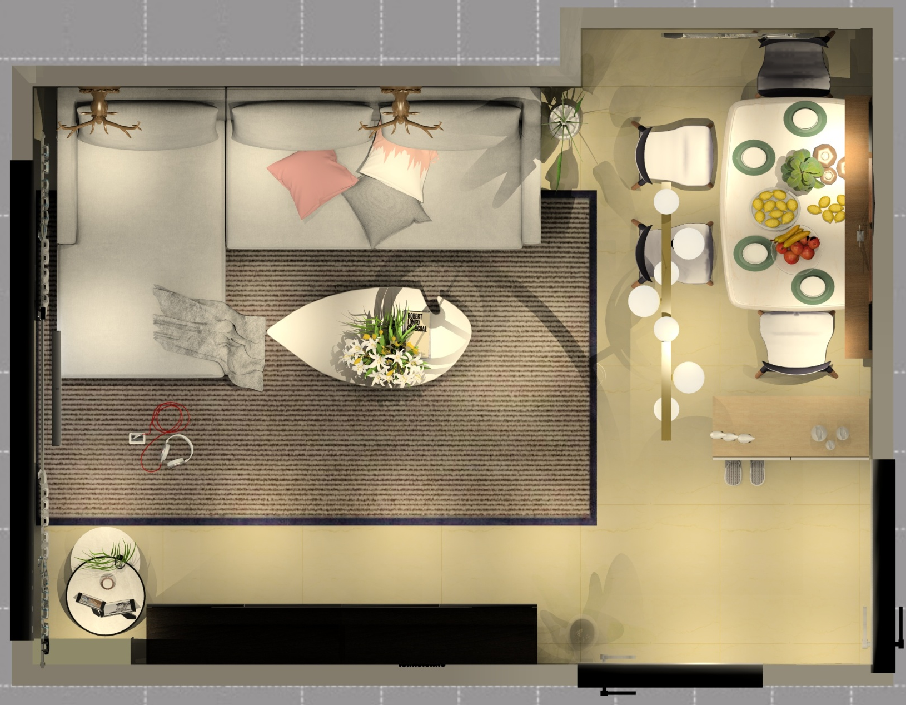
LIVING ROOM FLOOR PLAN
Living & Dinning – additional seating area, TV Unit & Dining & Shoe rack.

Slide 14
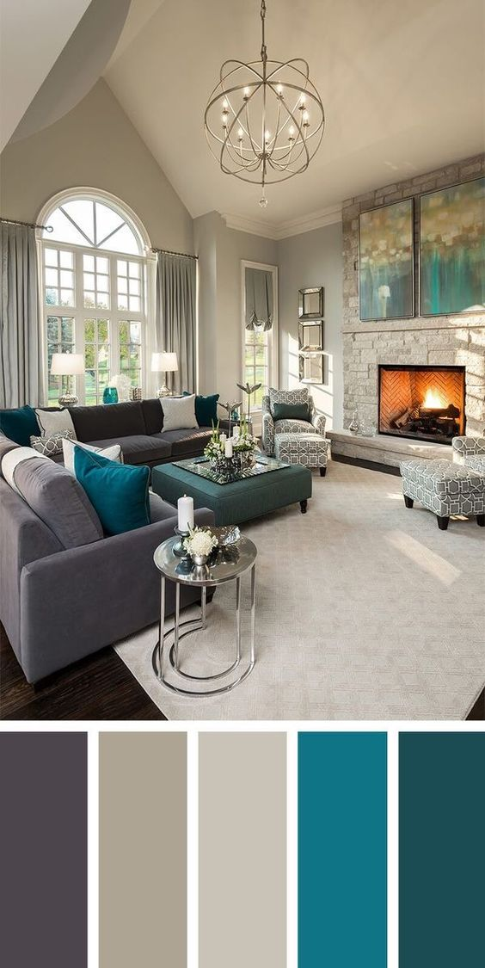
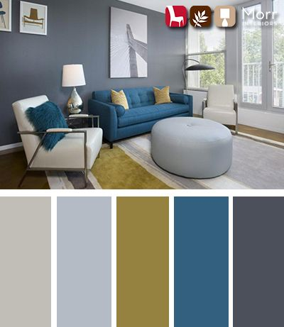
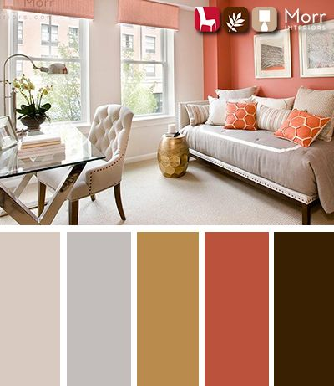
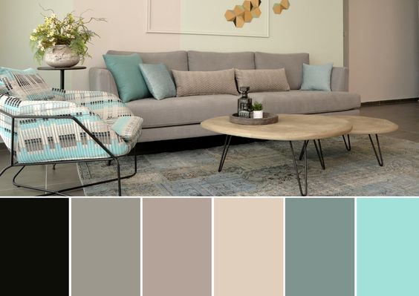
LIVING ROOM COLOUR PALETTES
Arrivae Personalization
Color scheme to provide a calm environment. Focal elements to be highlighted.

Slide 15
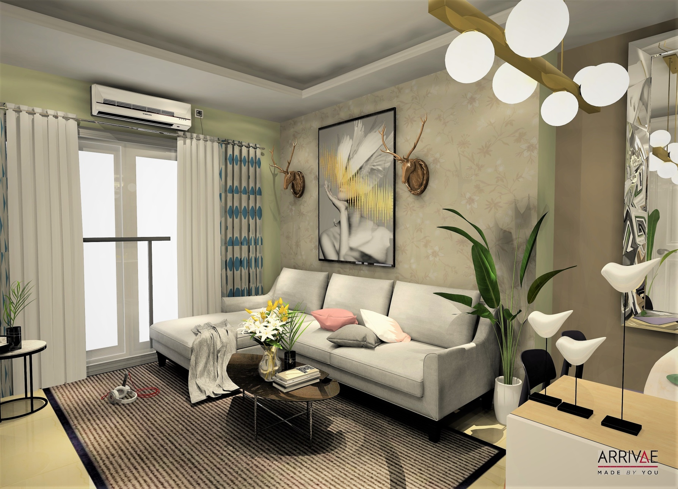
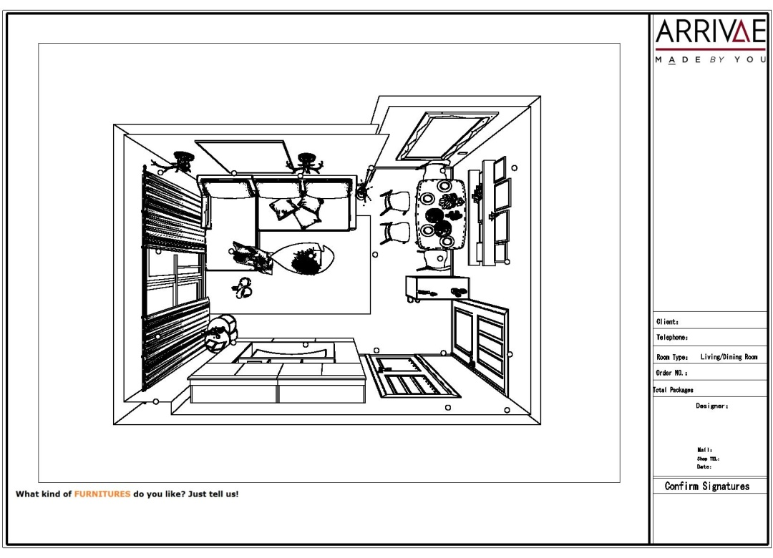
LIVING AREA
Arrivae Personalization
Utilization of minimal colours to accentuate the space to appear larger

Slide 16
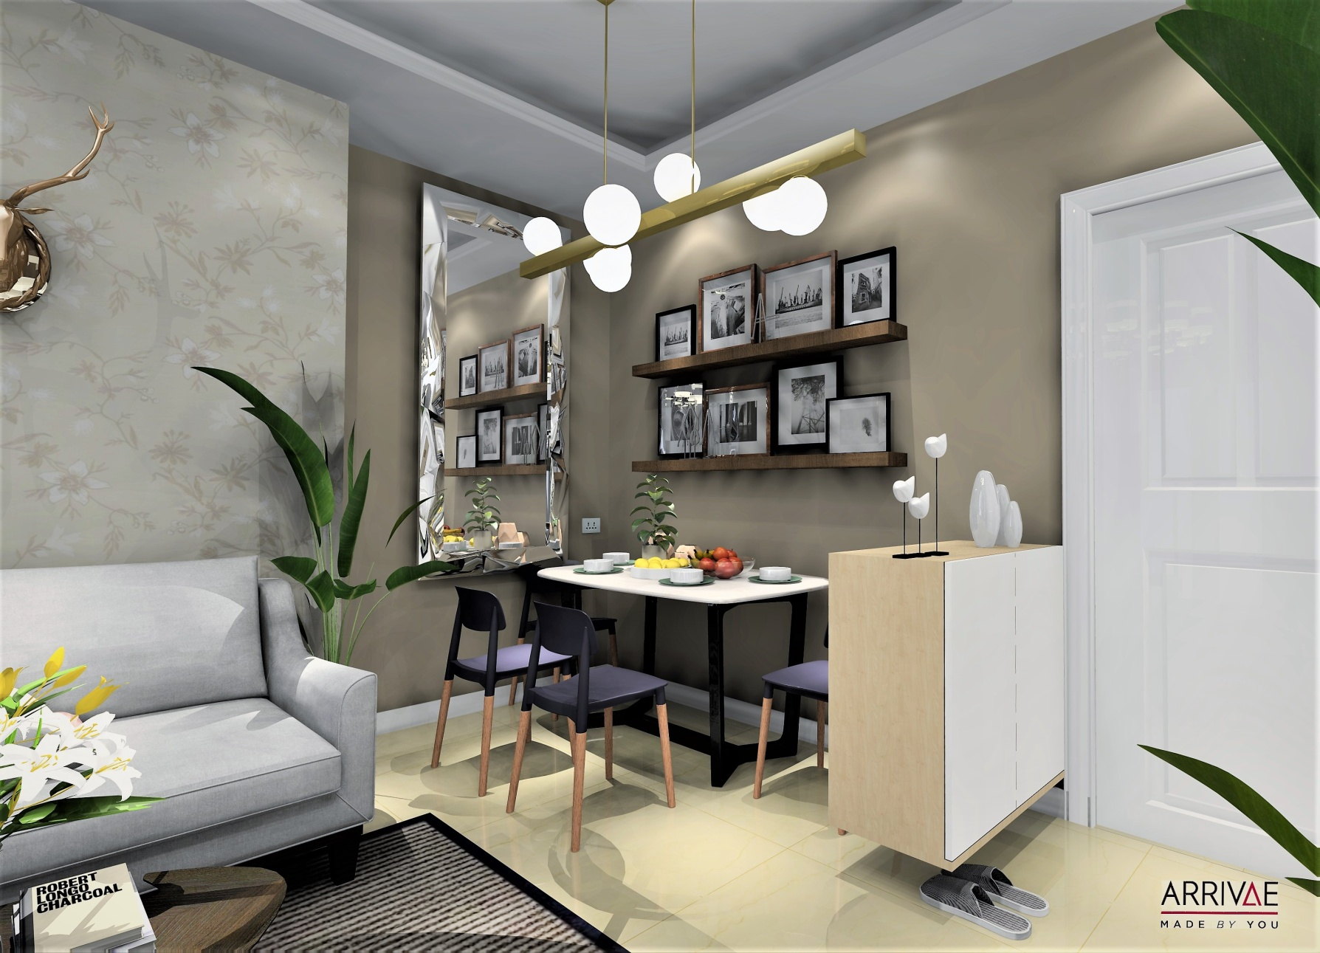
LIVING AREA
Arrivae Personalization
Sleek furniture to make the space look larger and more emphasis on comfort.

Slide 17
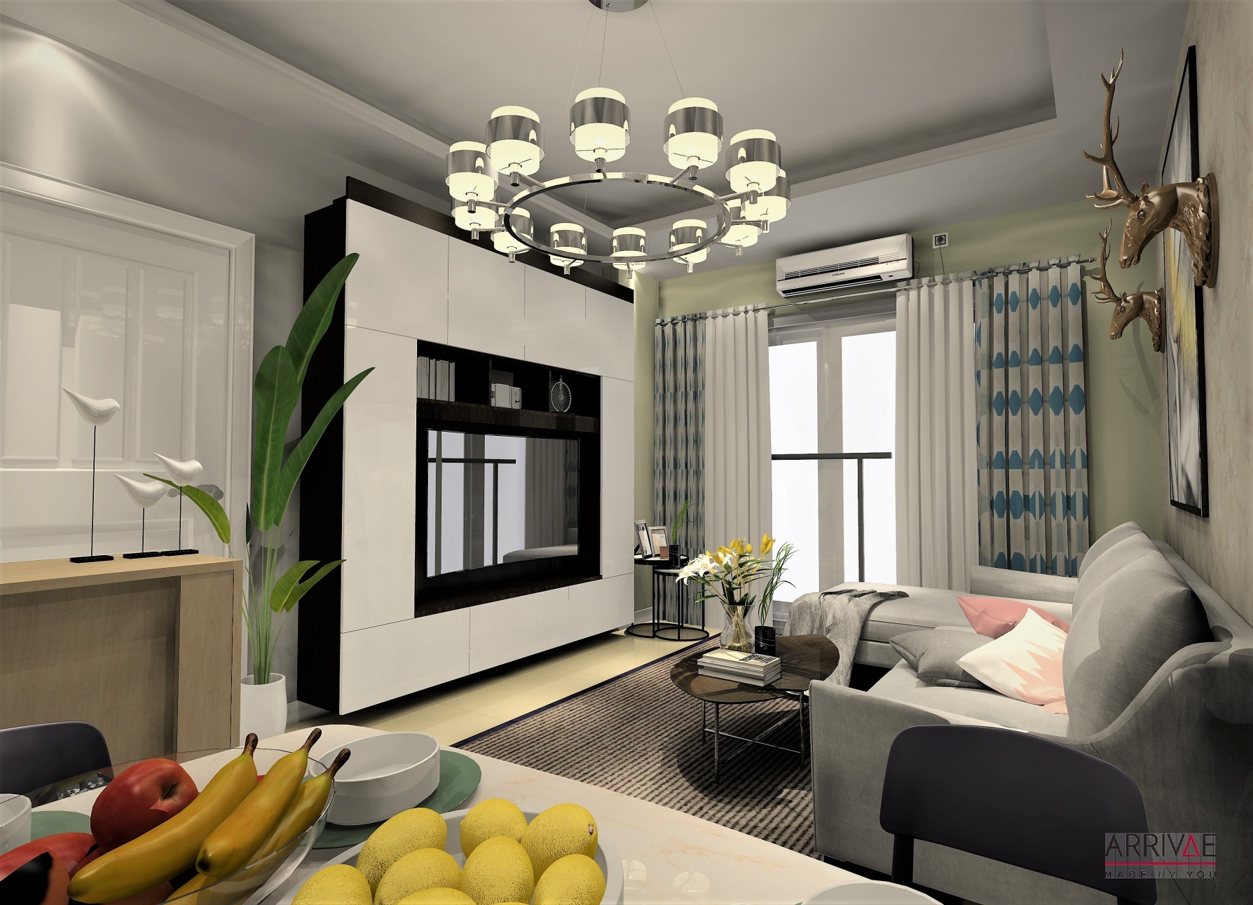
LIVING AREA
Arrivae Personalization
TV Unit designed for maximum storage space utilization

Slide 18
MASTER BEDROOM PROPOSAL

Slide 19
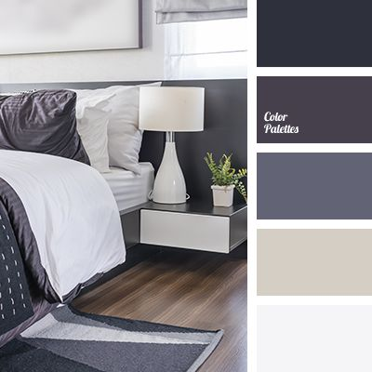
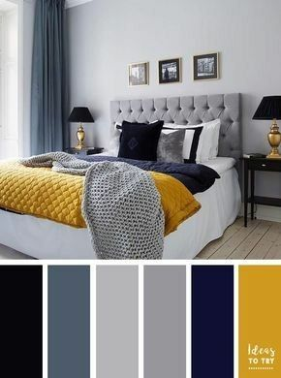
MASTER BEDROOM COLOUR PALETTES
Arrivae Personalization
Color scheme to provide a calm environment. Focal elements to be highlighted.

Slide 20
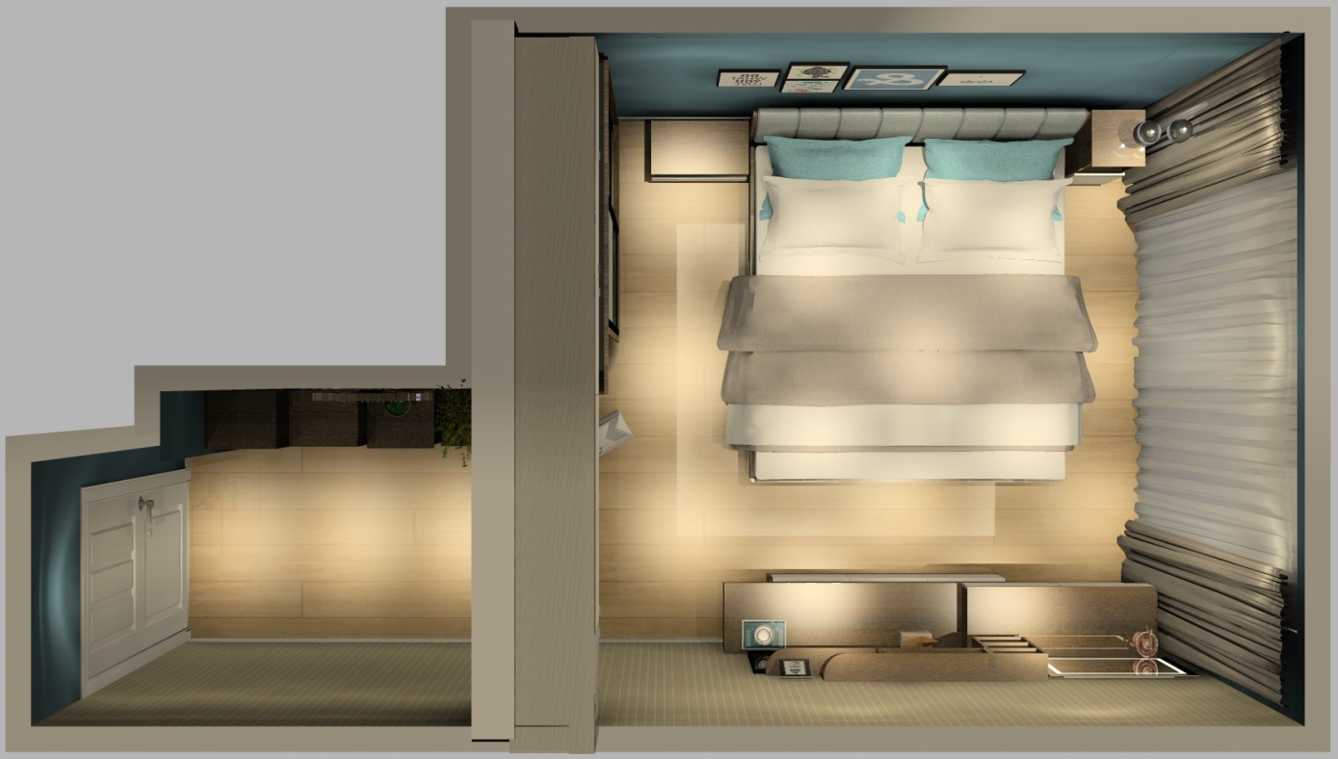
MASTER BEDROOM FLOOR PLAN
Master Bedroom – Sleeping, Reading space, Book storage space, Dresser.
Husband – Work, Reading, Watch News.
Wife – Work, Reading, Watching TV.

Slide 21
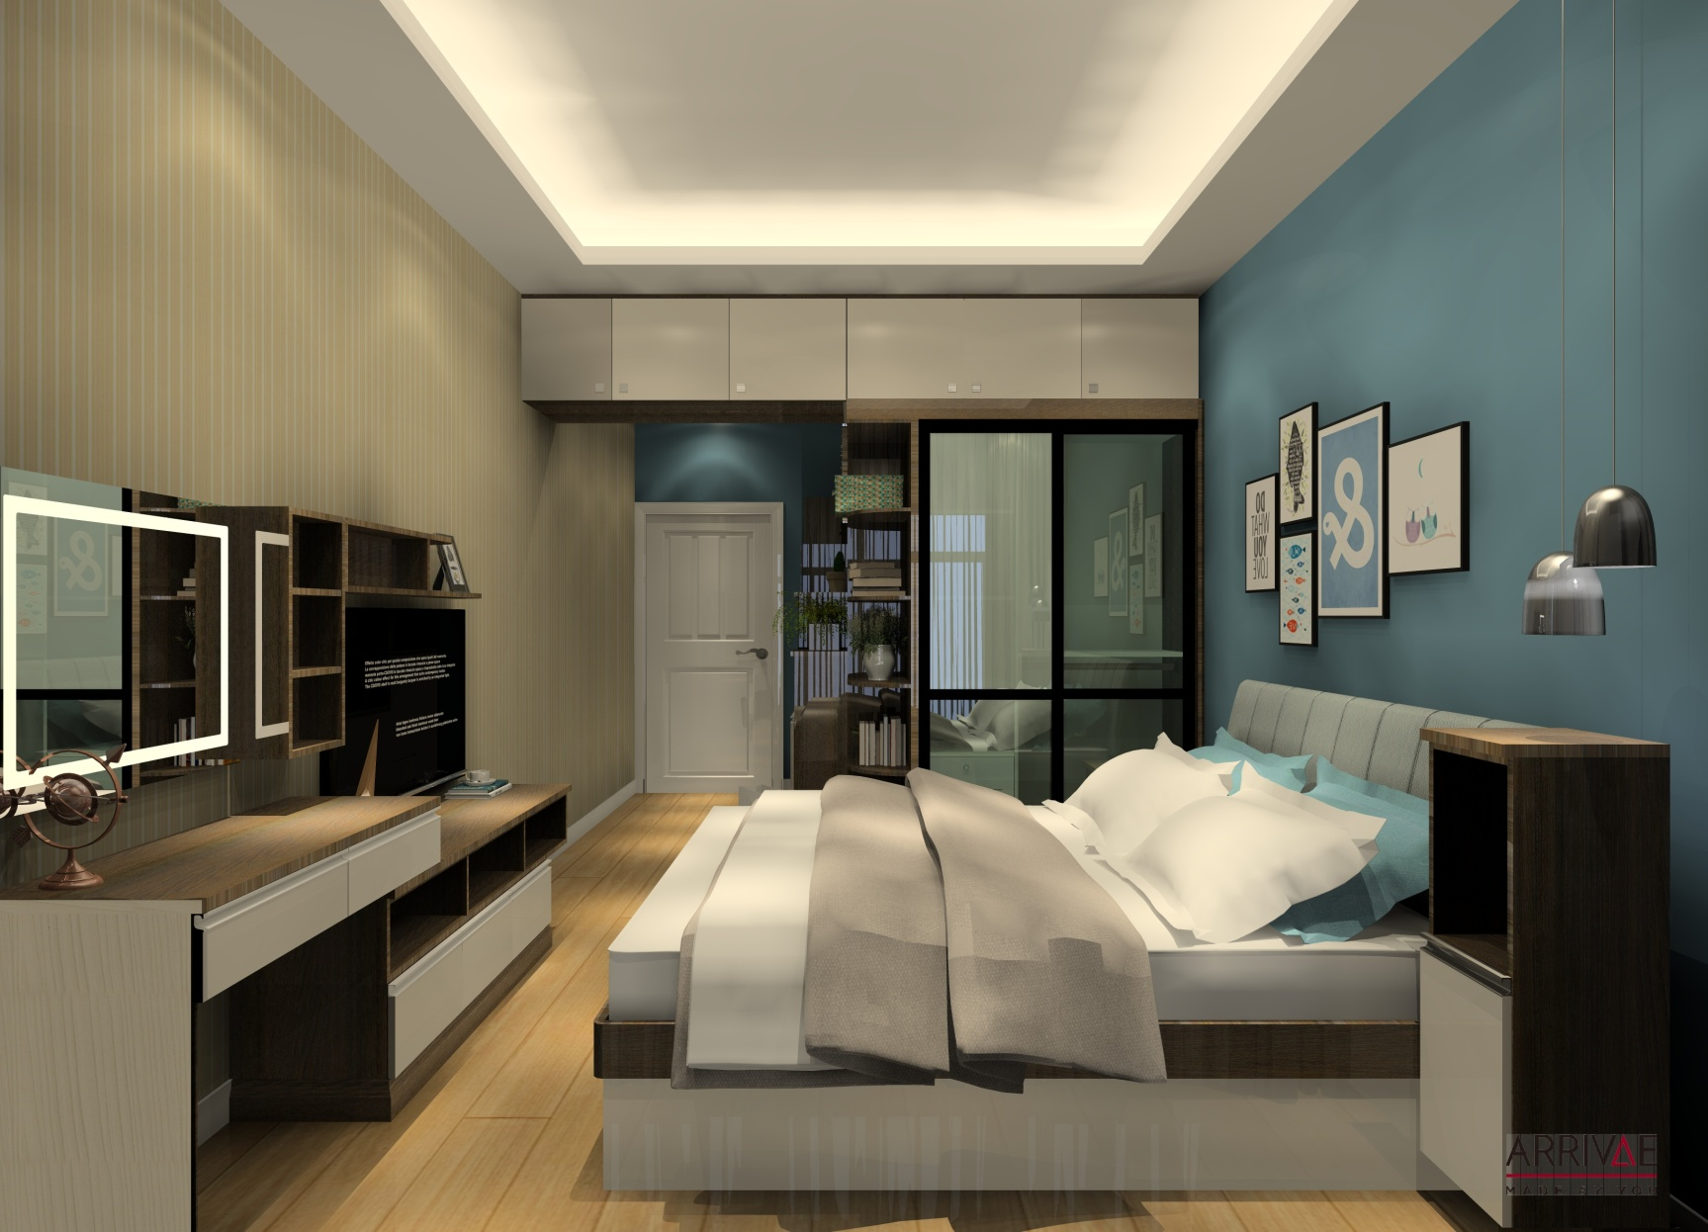
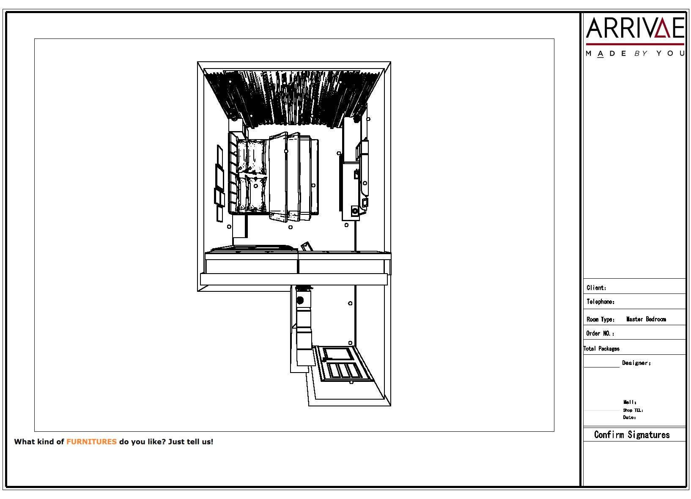
MASTER BEDROOM FLOOR PLAN
Arrivae Personalization
Glossy textures used to give luxury feel to the space

Slide 22
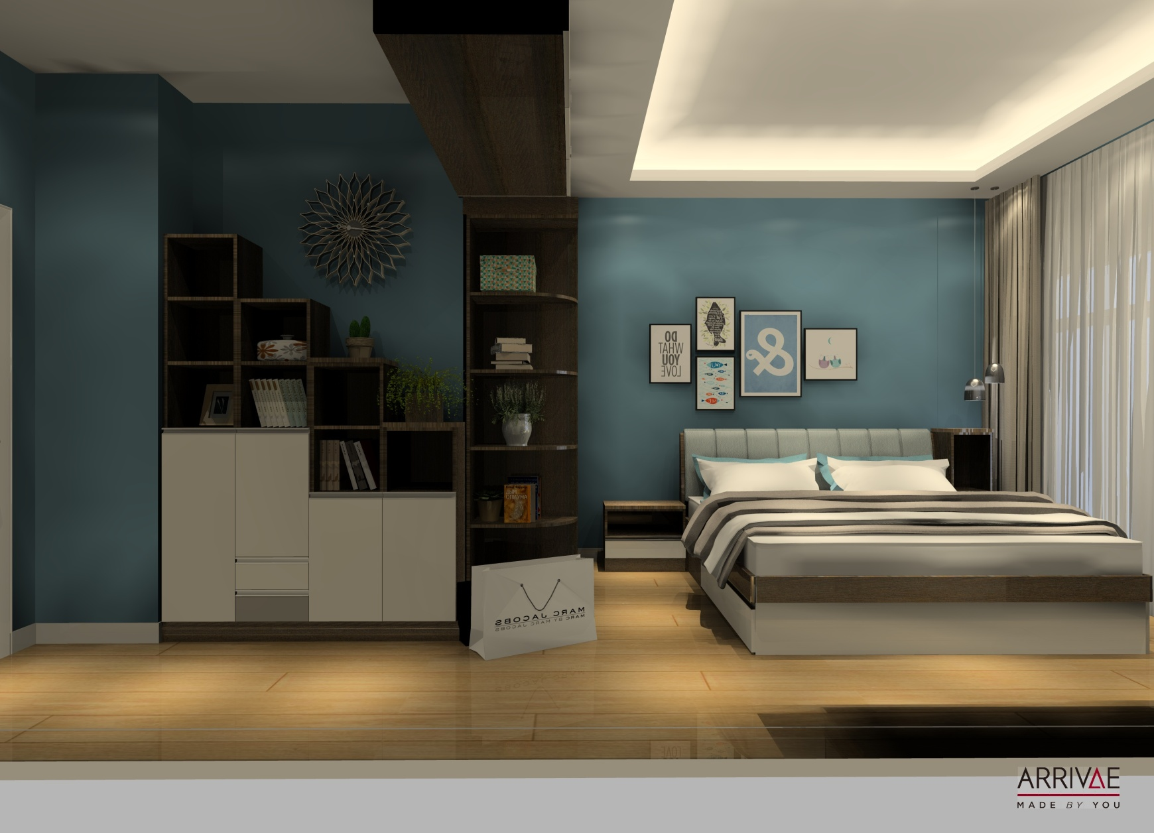
MASTER BEDROOM
Arrivae Personalization
Smallest area space utilized for smart storage

Slide 23
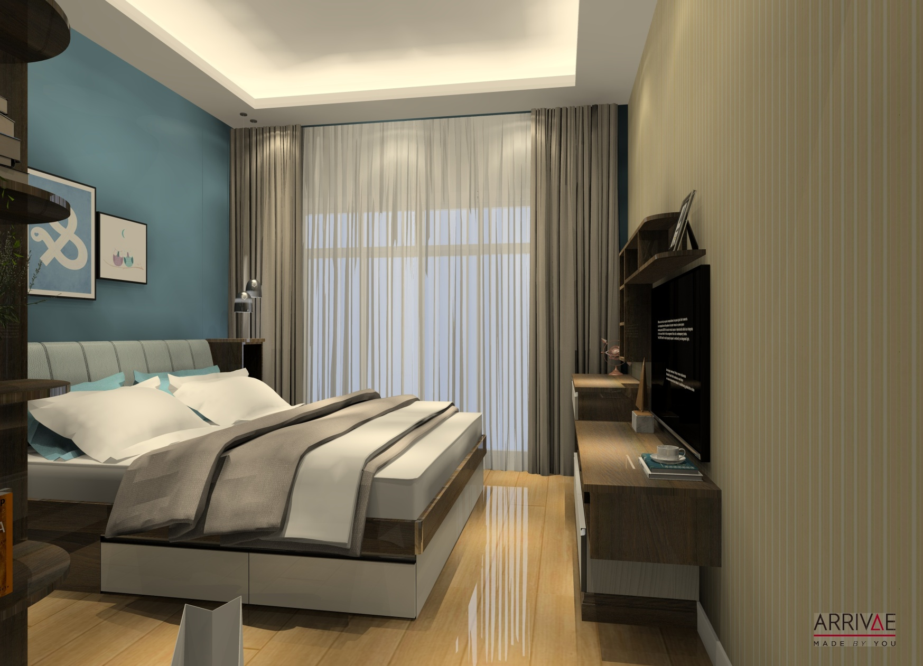
MASTER BEDROOM
Arrivae Personalization
Basic False ceiling used to highlight the walls

Slide 24
DAUGHTER’S BEDROOM PROPOSAL

Slide 25
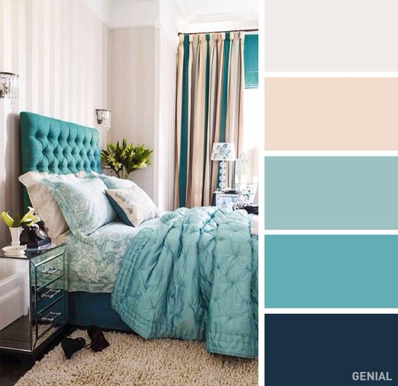
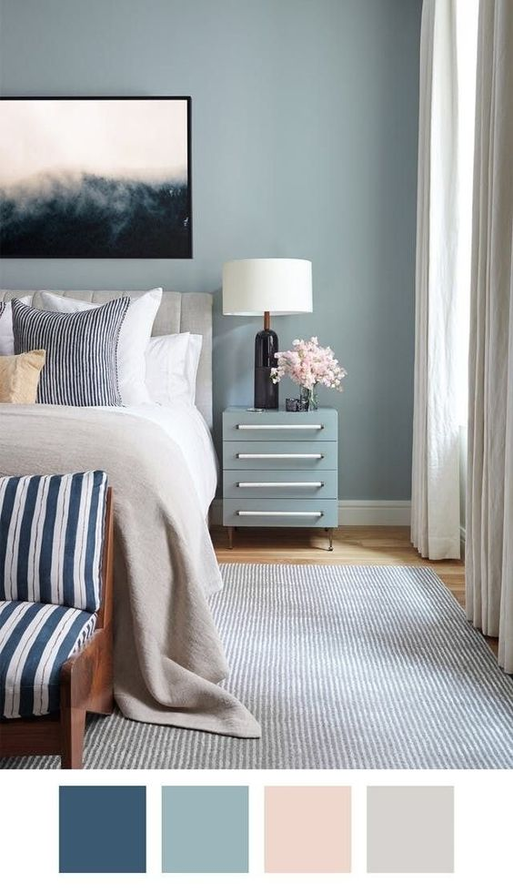
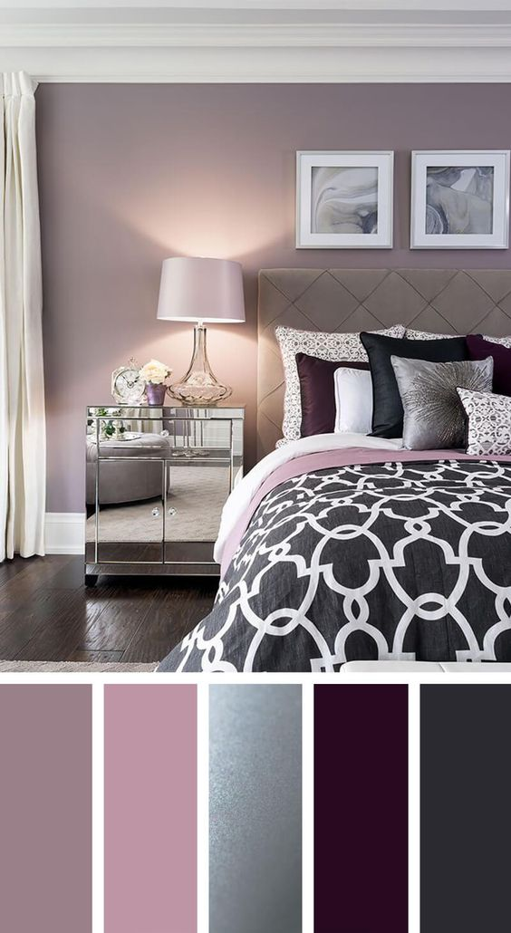
DAUGHTER’S BEDROOM COLOUR PALETTE
Arrivae Personalization
Color scheme for relaxed atmosphere.

Slide 26
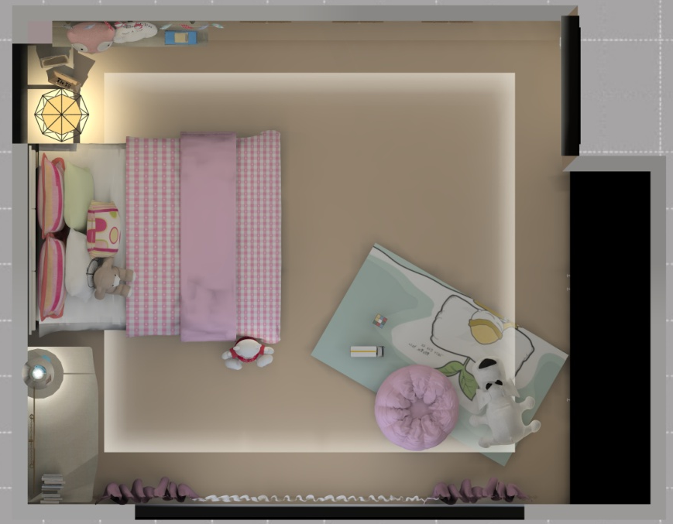
DAUGHTER’S BEDROOM FLOOR PLAN
Daughter’s Bedroom – Sleeping, Reading space, Play area , Dresser.
Daughter – Work, Reading, Socializing with friends.

Slide 27
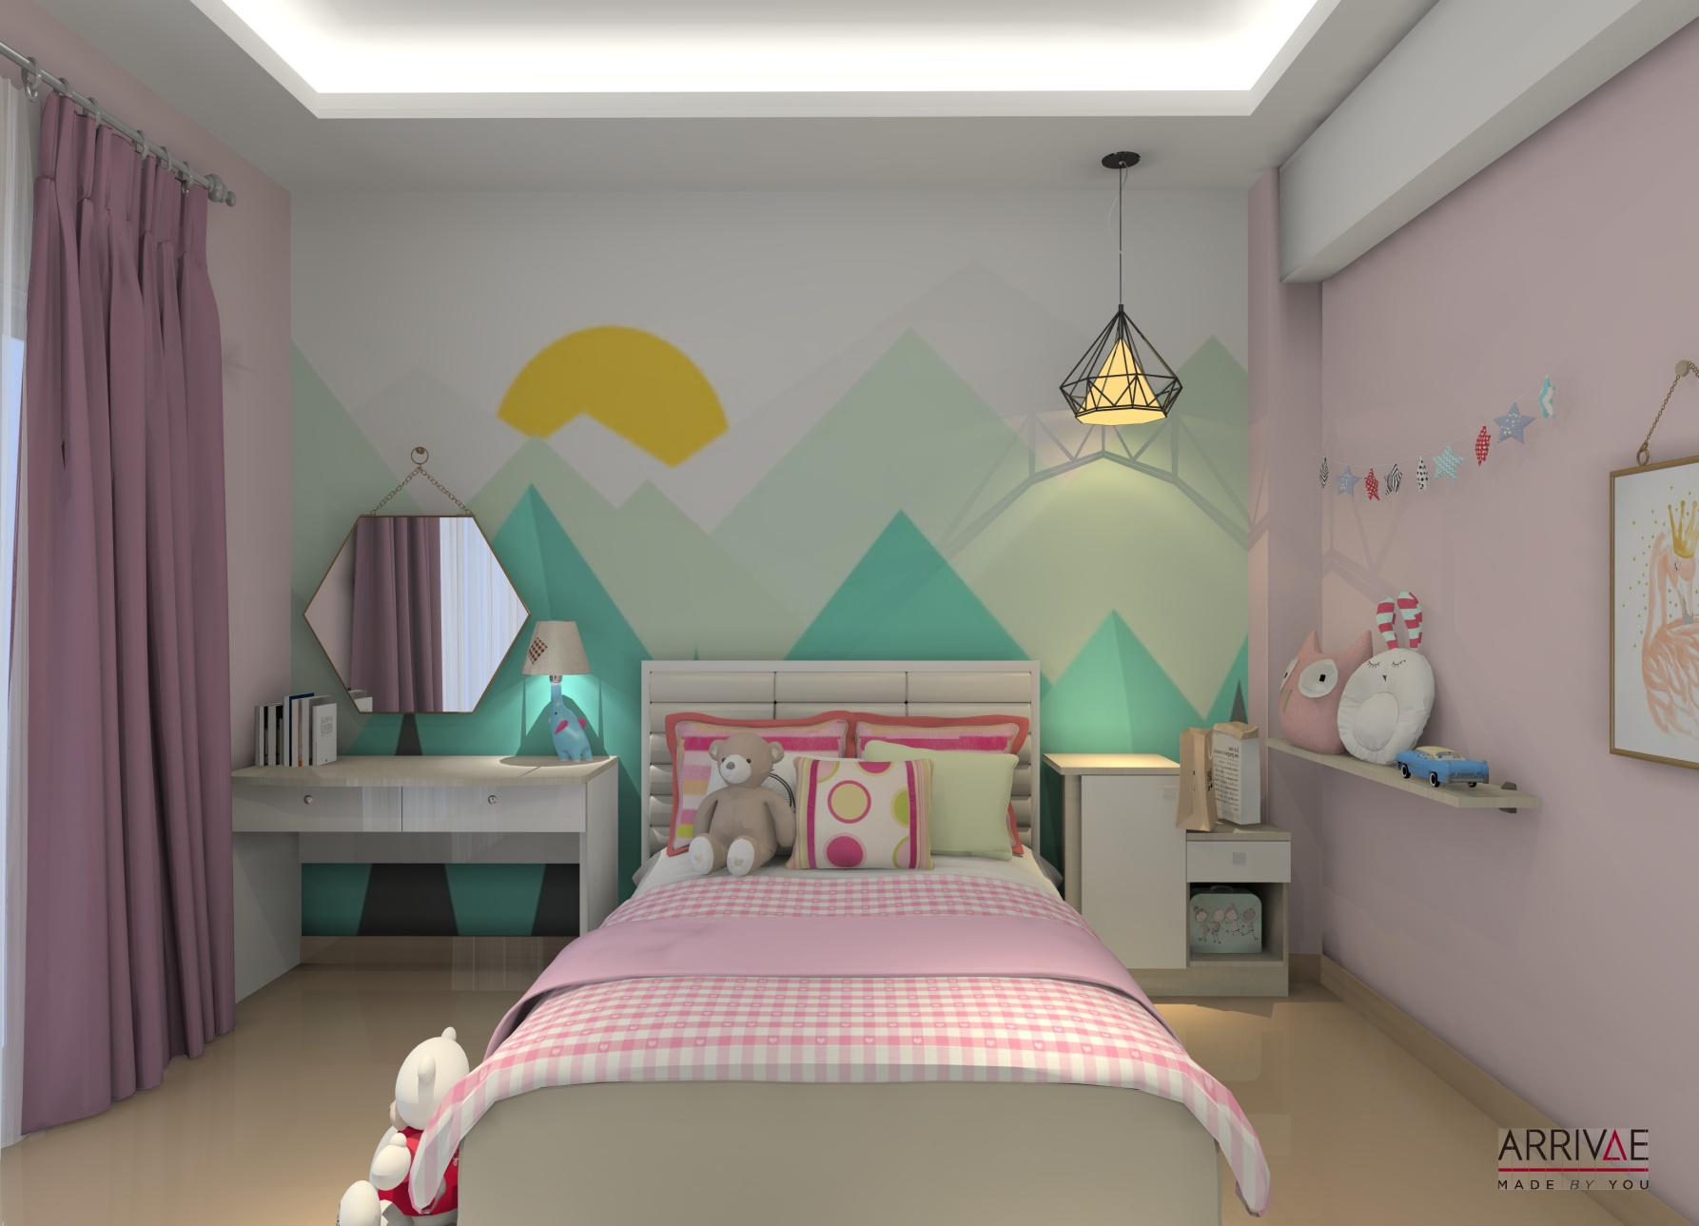
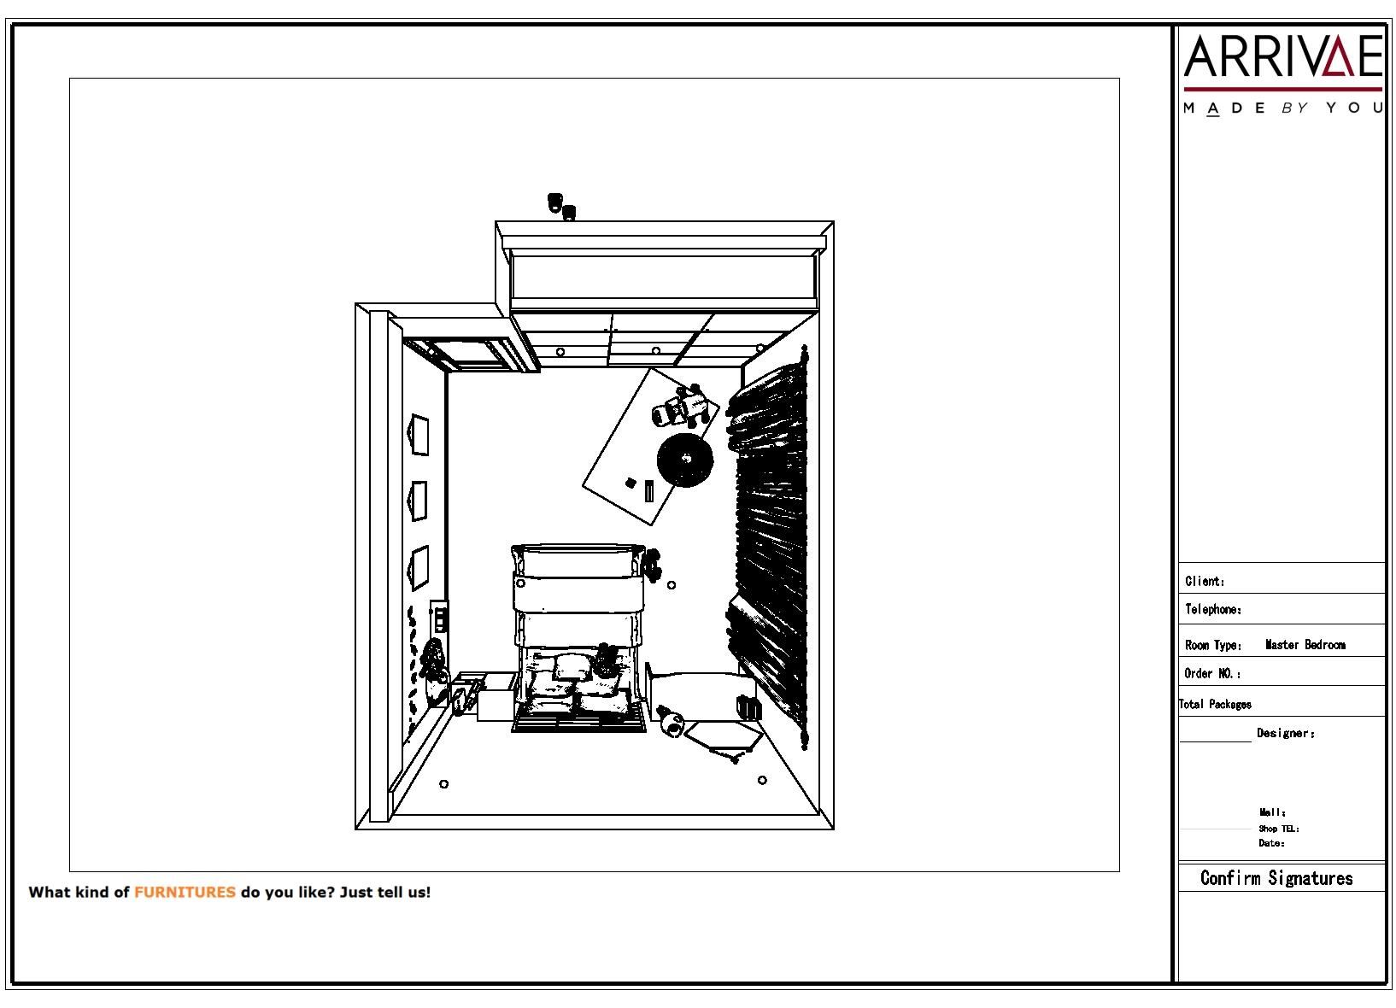
DAUGHTER’S BEDROOM
Arrivae Personalization
Use of trendy Pastel colours on the walls with basic colours on furniture

Slide 28
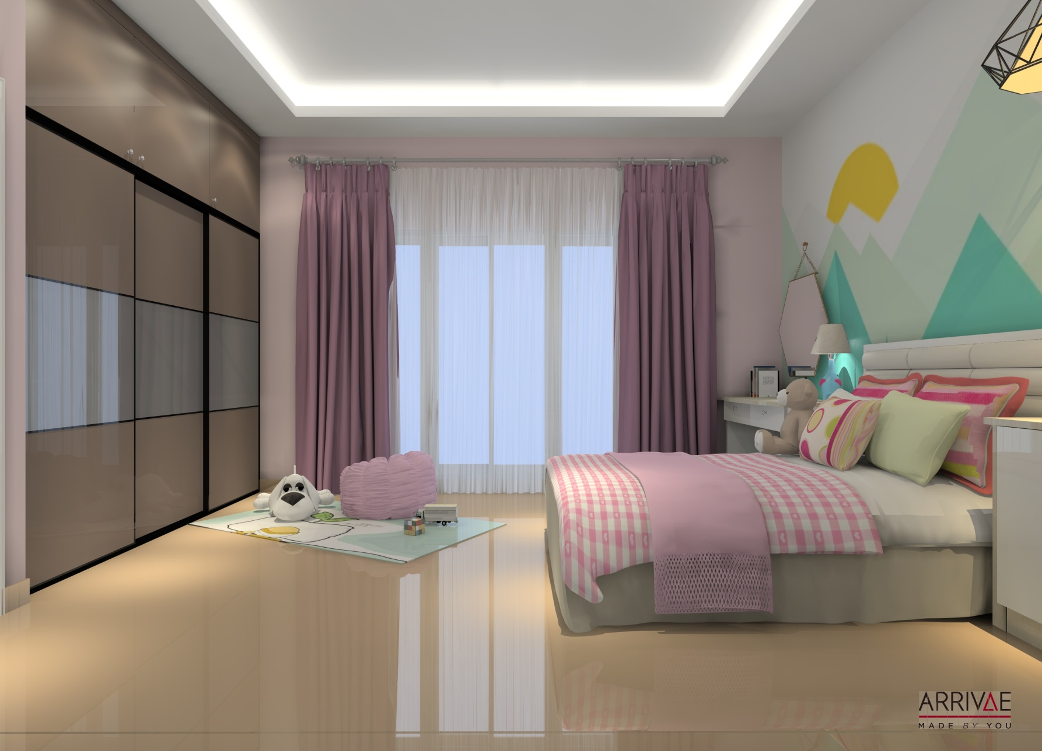
DAUGHTER’S BEDROOM
Arrivae Personalization
More space utility done with use of Sliding wardrobe

Slide 29
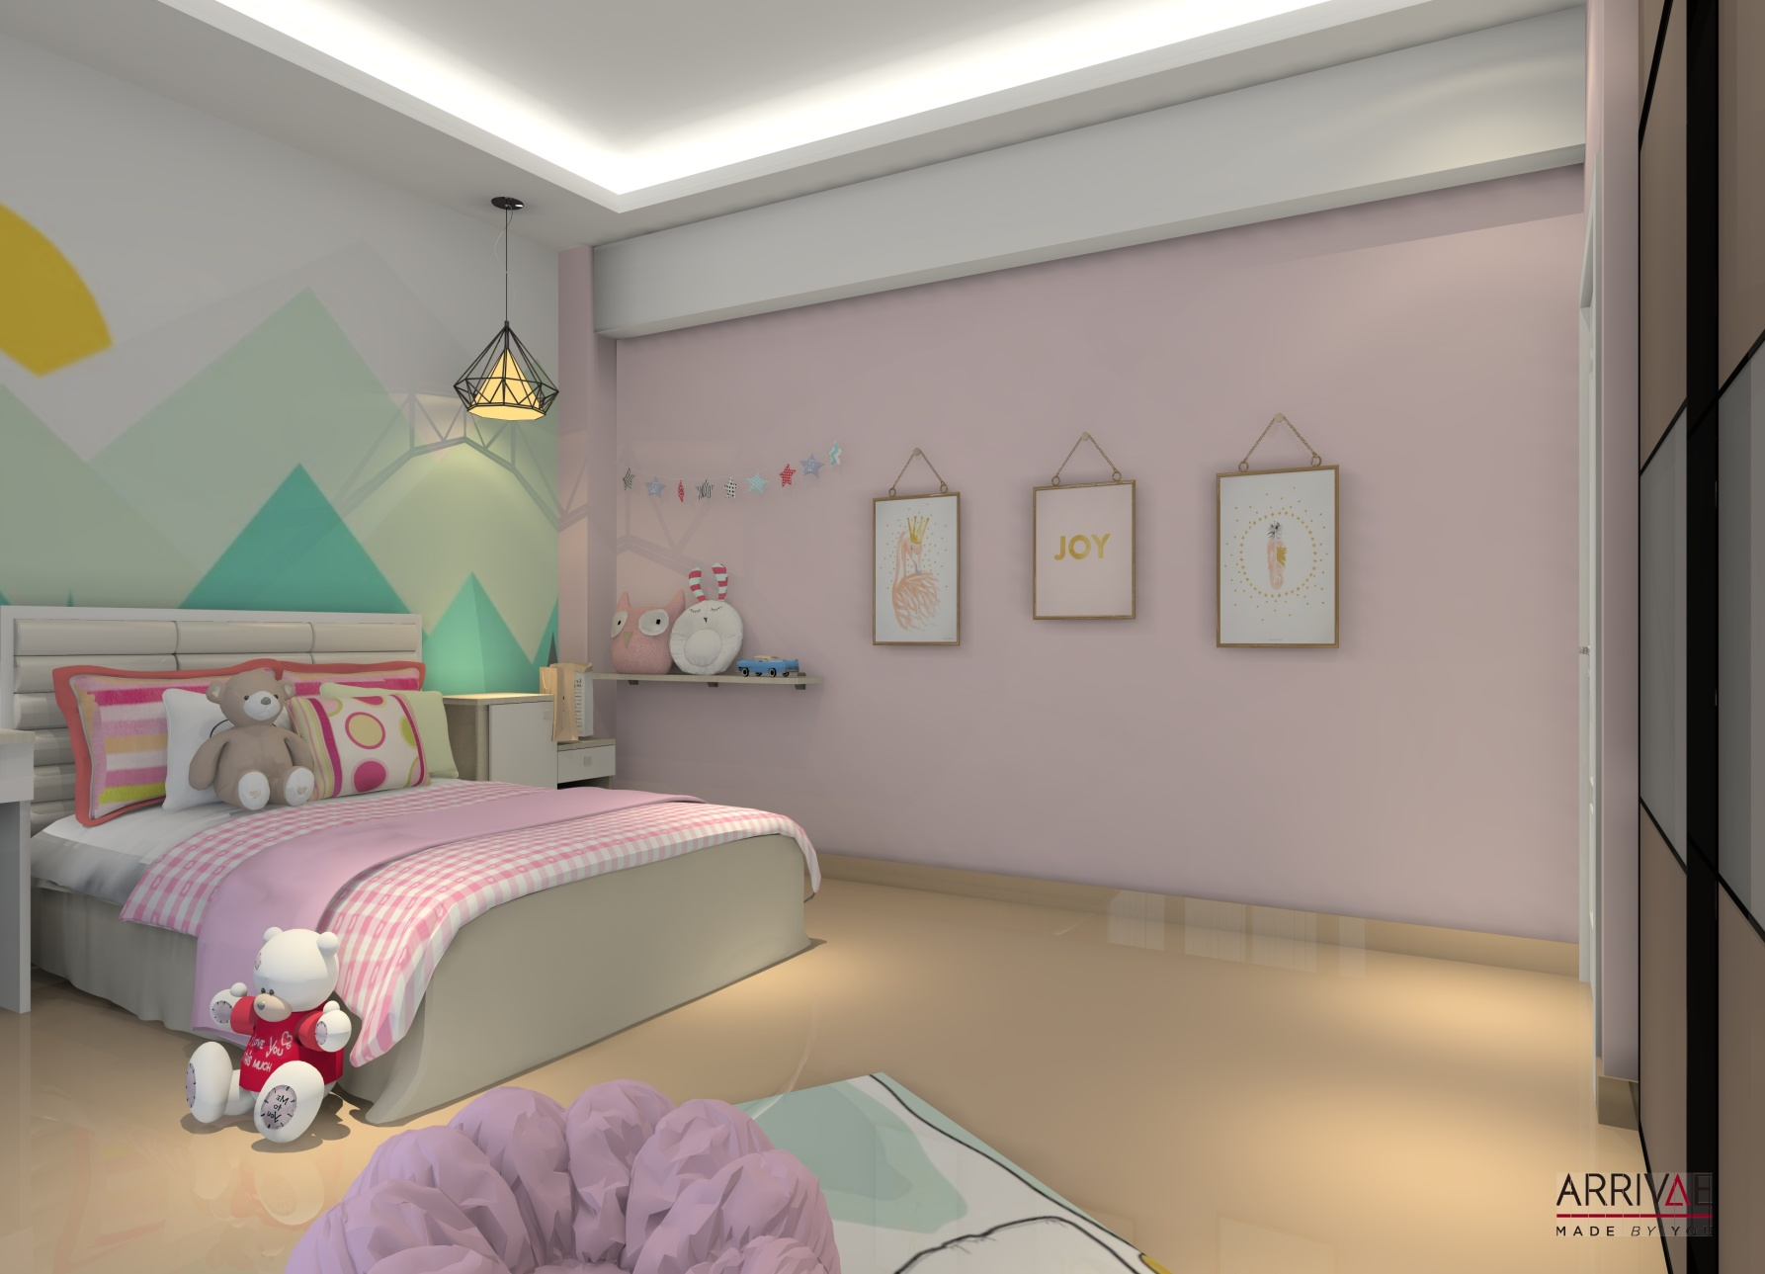
DAUGHTER’S BEDROOM
Arrivae Personalization
A plain wall for the kid to accessorize

Slide 30
SON’S BEDROOM / STUDY ROOM PROPOSAL

Slide 31
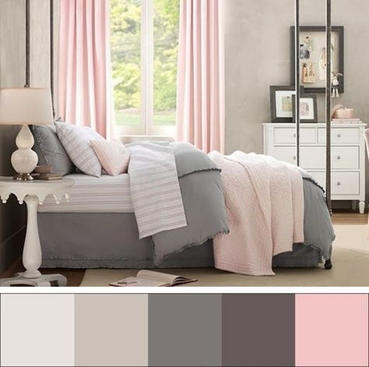
SON’S BEDOOM / STUDY ROOM COLOUR PALETTE

Slide 32
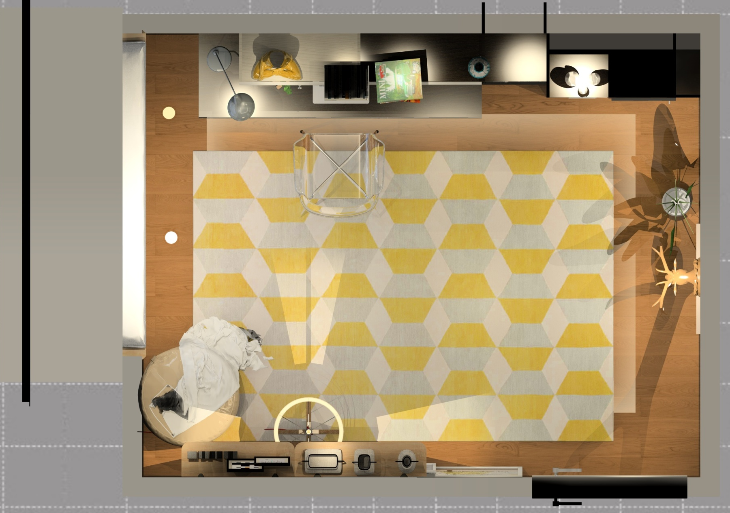
SON’S BEDROOM/STUDY ROOM FLOOR PLAN
Son’s Bedroom / Study Room – Sleeping, Reading space, Place for guitar.
Son – Study, Playing Guitar, Sports

Slide 33
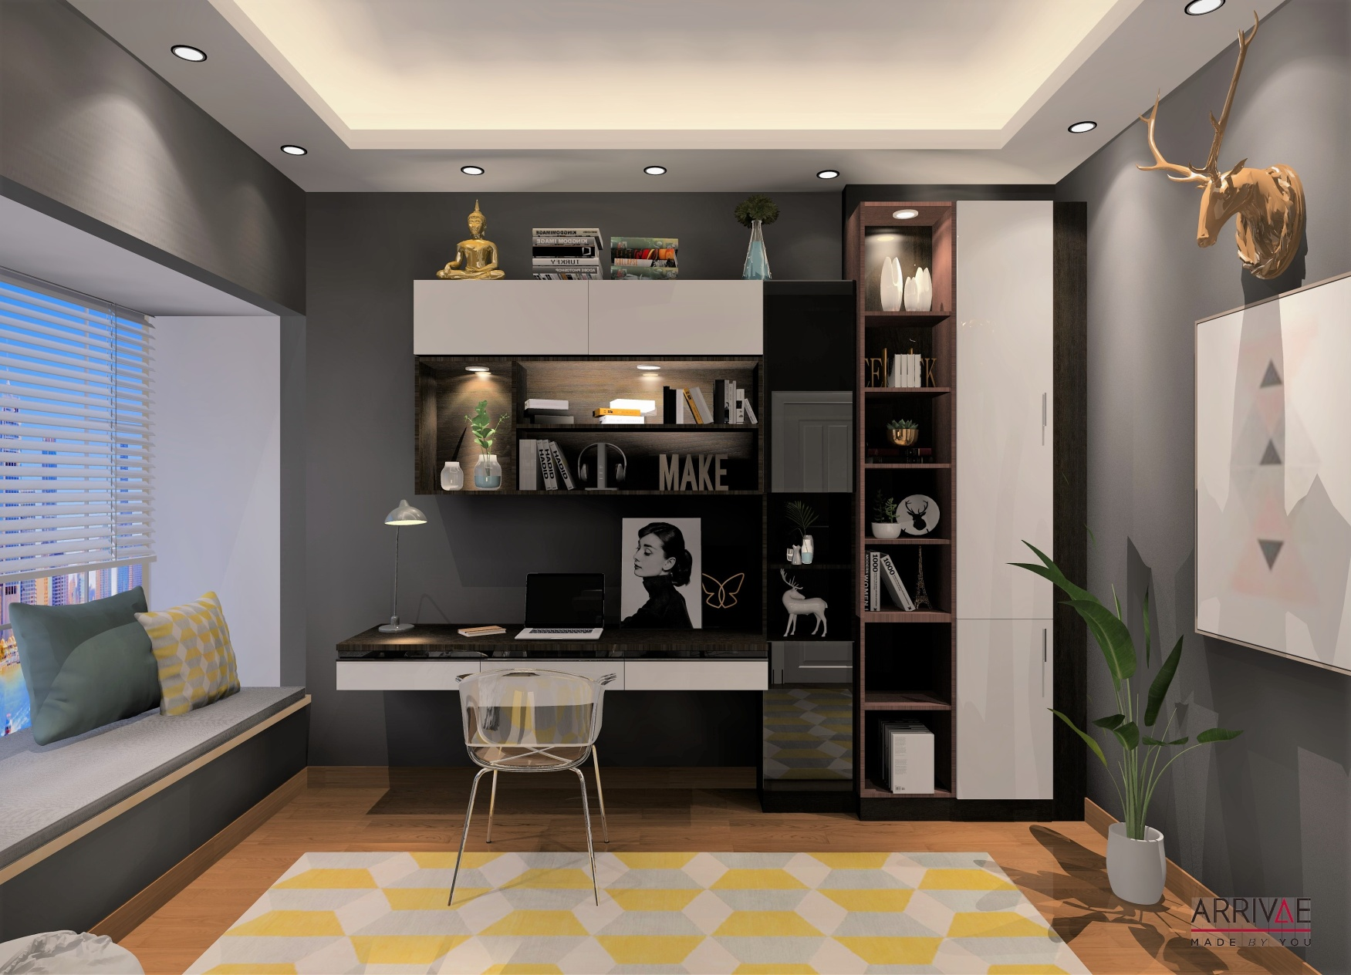
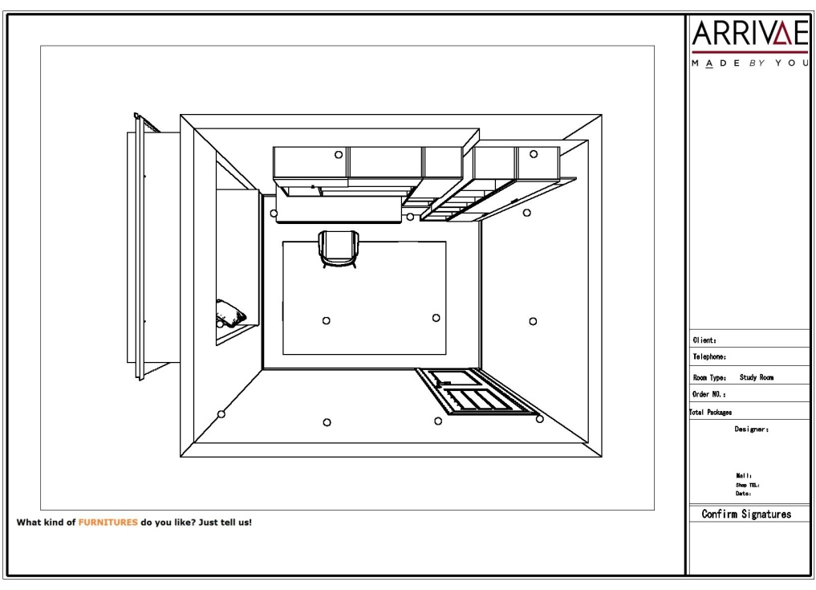
SON’S BEDROOM
Arrivae Personalization
Ample Storage open-closed storage for books and decor

Slide 34
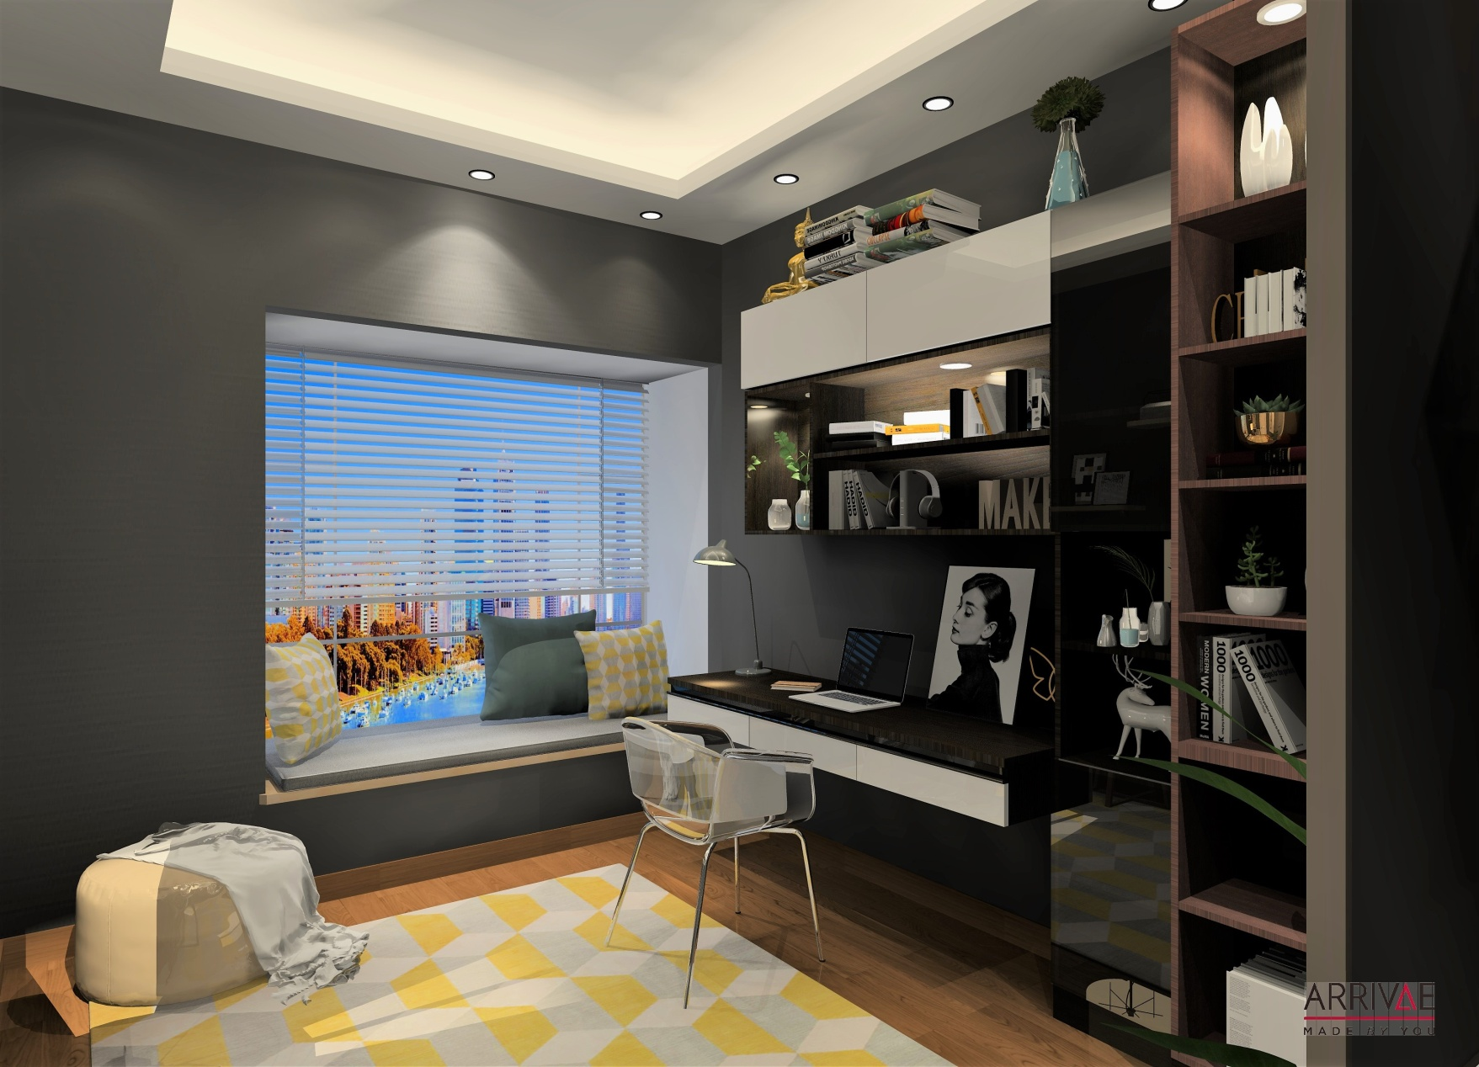
SON’S BEDROOM
Arrivae Personalization
Cozy niche informal seating created alongside the window

Slide 35
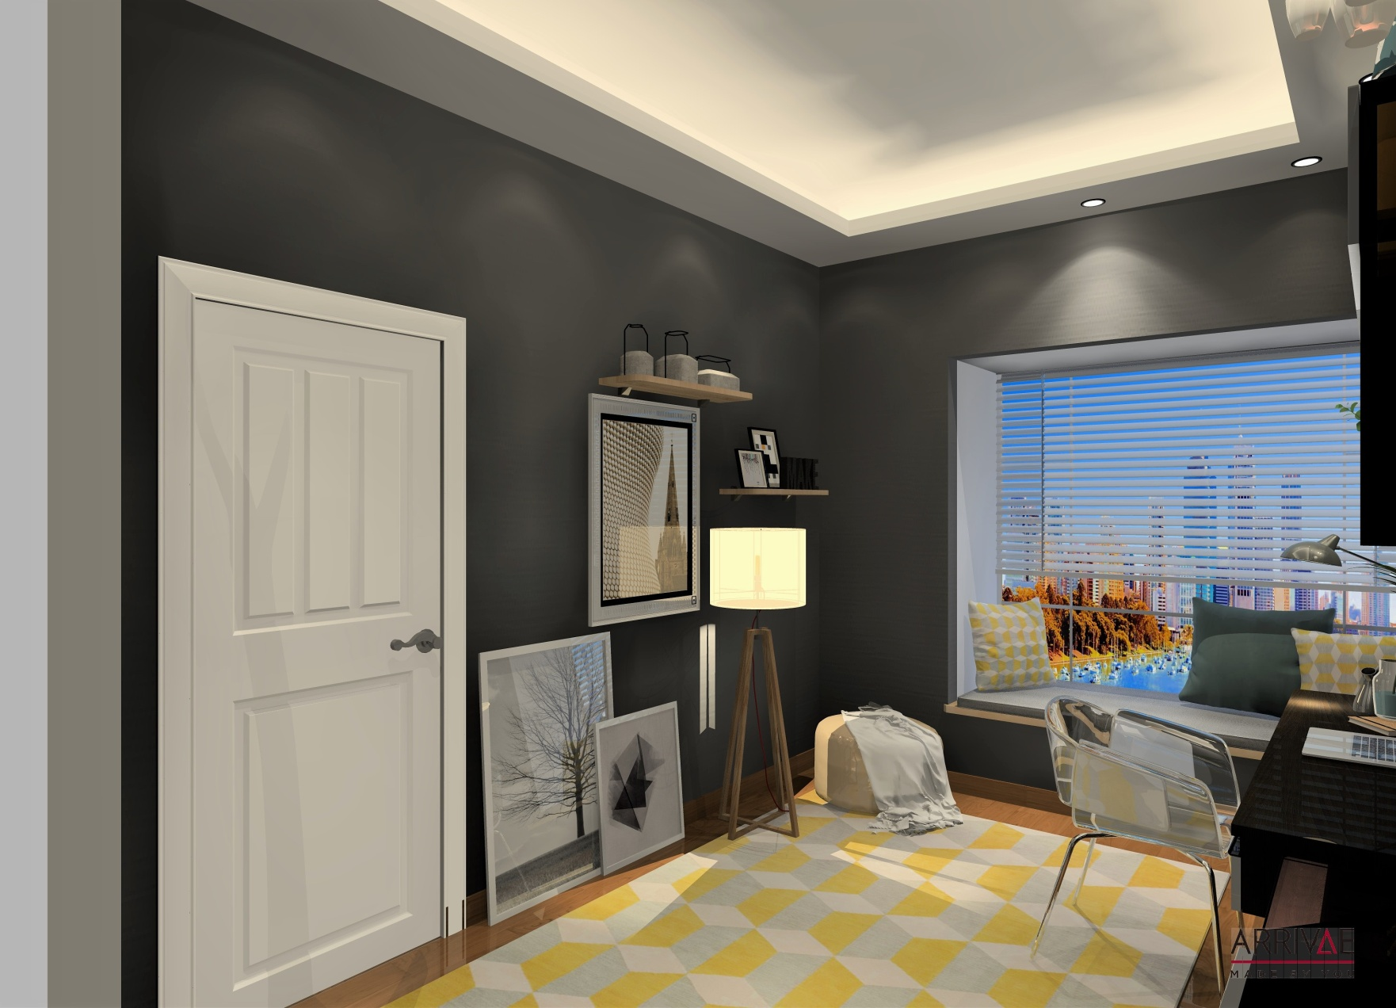
SON’S BEDROOM
Arrivae Personalization
Bare minimum furniture to use the room in multipurpose way

Slide 36
DÉCOR IDEAS

Slide 37
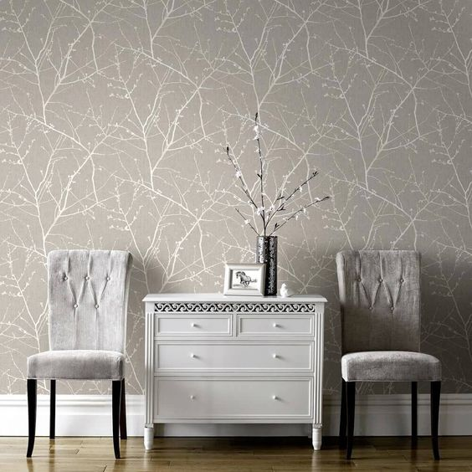
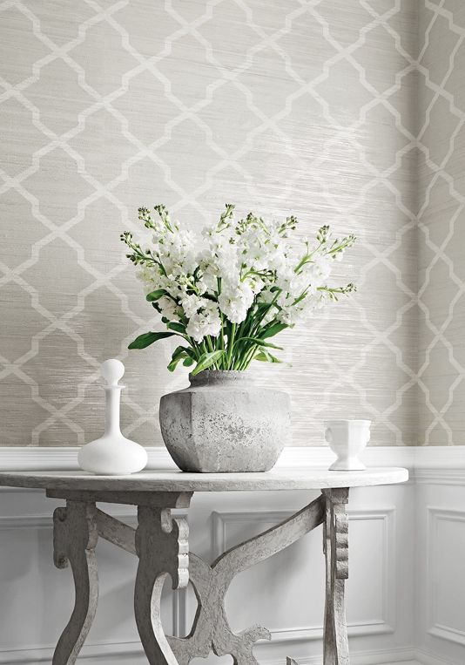
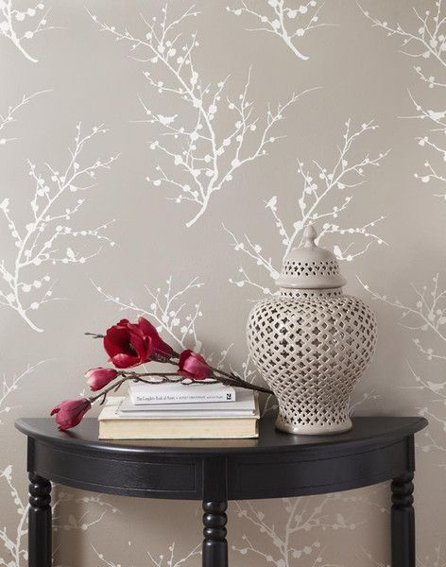
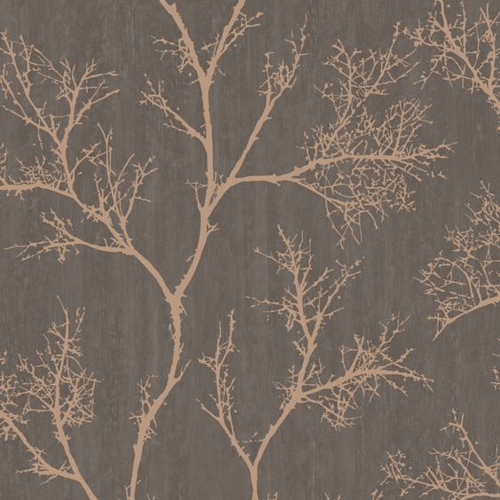
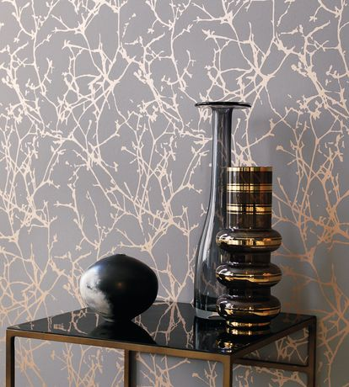
WALLPAPERS

Slide 38
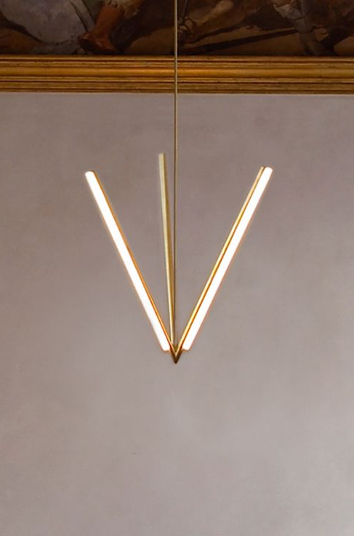
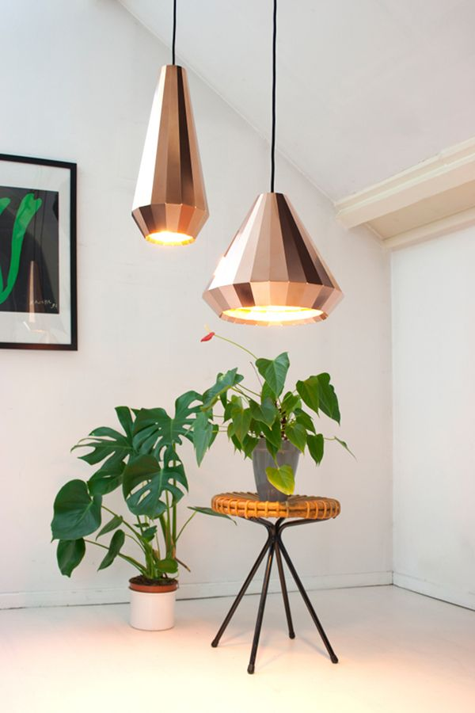
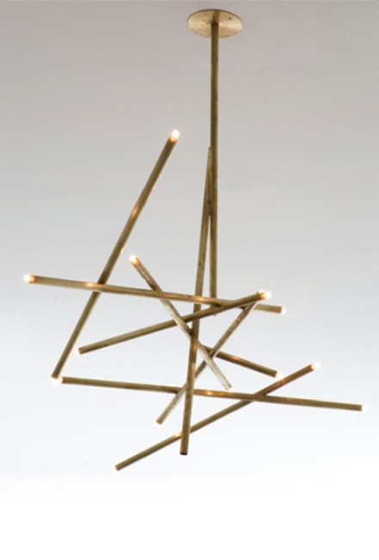
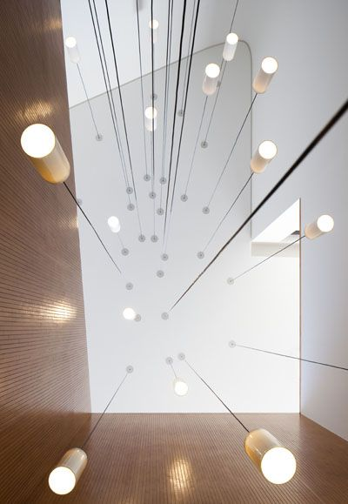
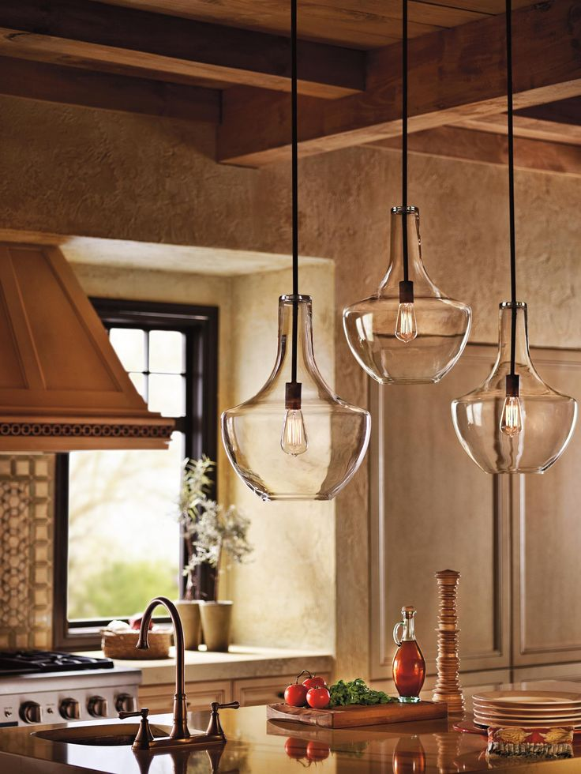
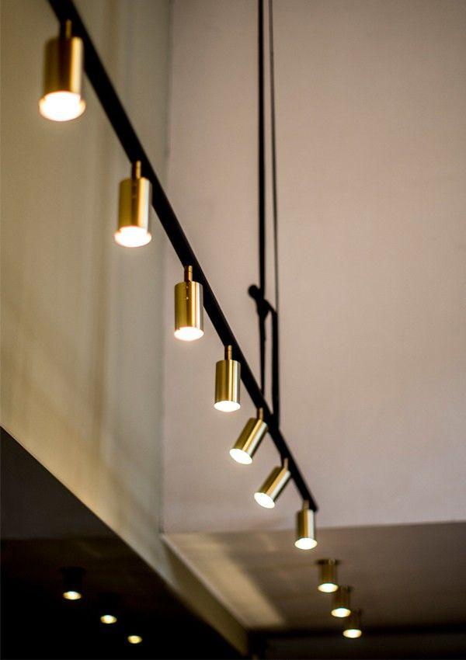
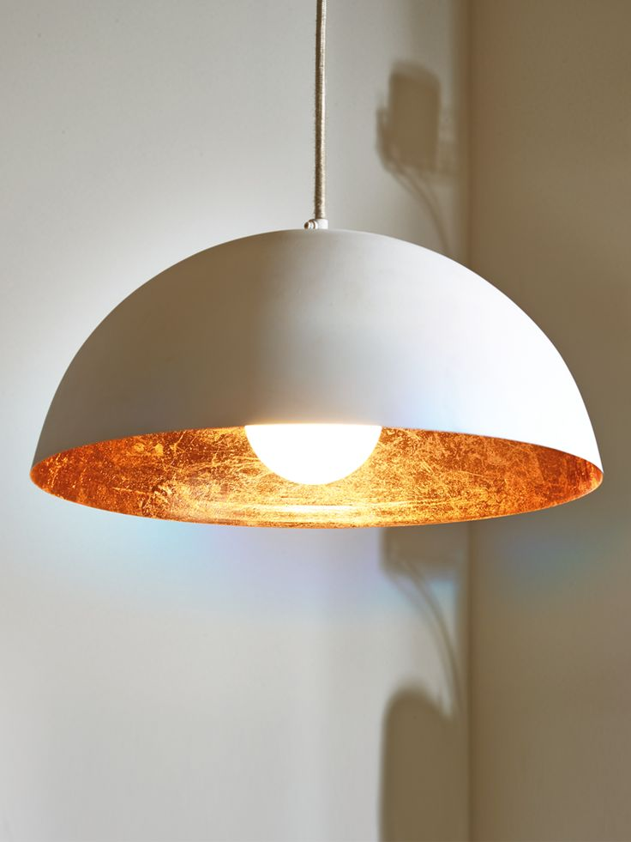
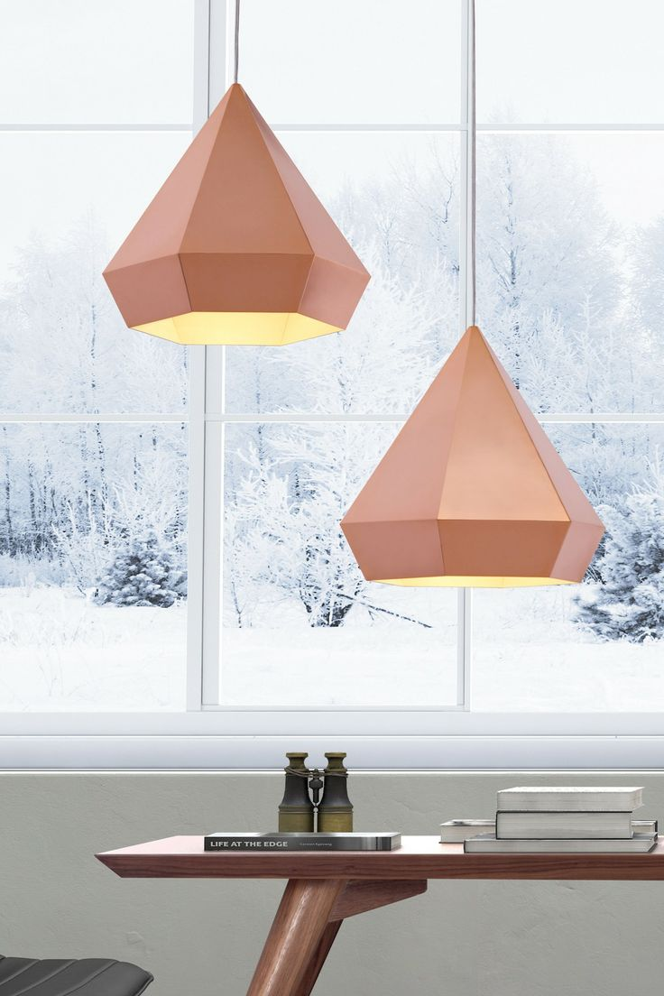
LIGHTING FIXTURES

Slide 39
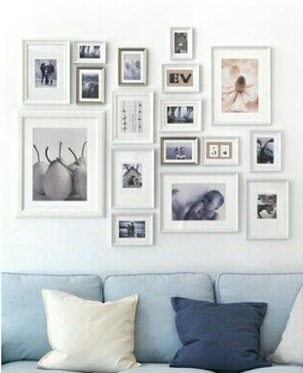
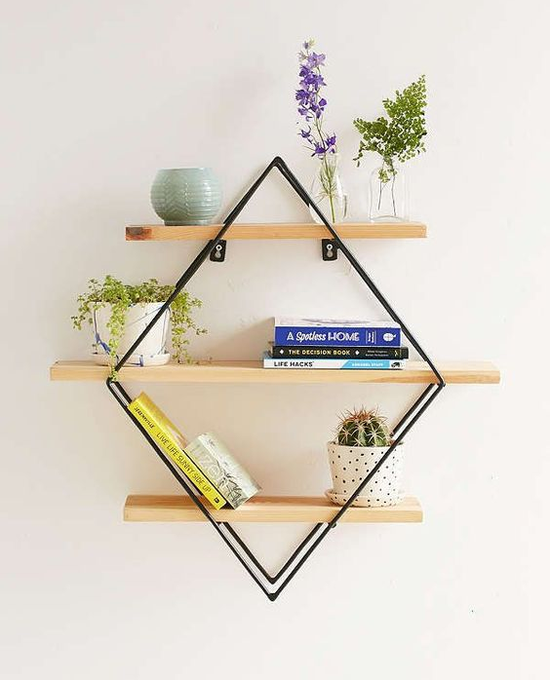
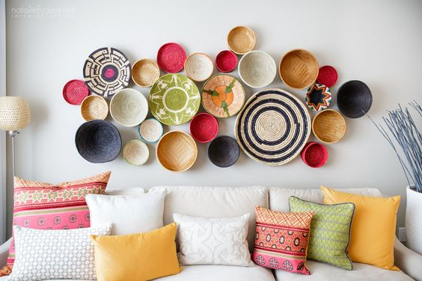
WALL DÉCOR IDEAS

Slide 40


Slide 41


